Slide 1




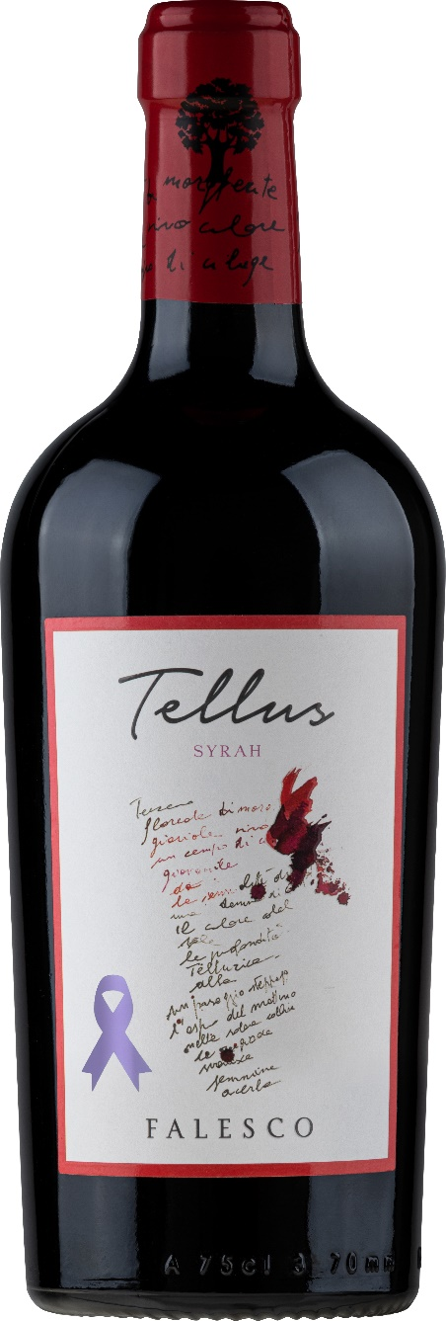
TENUTA TELLUS
LAZIO
TELLUS SYRAH 2020
SYRAH
LAZIO
IGP
GRAPES
syrah 100%
PRODUCTION ZONE
castiglione in teverina
SURFACE OF THE VINEYARD
20 ha
ALTITUDE OF THE VINEYARD
300 meters above sea level
Type of soil
sandy, medium texture
Training system
spur cordon
Density of vines
5.000 per ha
Production per hectare
7500 kg
Yield of grapes into wine
65%
Average age of vines
13 YEARS
Harvest time
SECOND WEEK of September
vinification
maceration on skins
Alcoholic fermentation
in stainless steel tanks for 14 days
Malolactic fermentation
totally carried out
alcoholic
13,85%
Total acidity
5,15 gr/lt
Dry extract
32,60 gr/lt
Ph
3,60
THE GRAPE AND THE VINEYARD
In order to obtain a wine that would best represent the great potential of the vineyard Lazio, we decided to focus our attention to the Syrah variety.
The treatment of individual plants, with particular reference to the training system and to a limited production, allow us to obtain grapes of great balance, in terms of sugar, as well as phenolic..
Then the fermentation continues at a temperature of 25-27°C. After the alcoholic fermentation, the wine is placed in oak barrels where the malolactic fermentation occurs.
THE WINE
A wine with an intense color and violet reflections, on the nose its scent is enhanced by hints of fresh fruit, cherry with spicy notes that blend with great balance and elegance to those of sweet and vanilla expressed from the wood. The taste is enveloping, silky, soft tannins, rich and persistent finish.
THE VINIFICATION
After harvesting and crushing the grapes are taken to a pre-cold maceration for 4 or 5 days at a temperature of 18-20°C. This technique brings out the best feature of the natural freshness and fragrance of the fruit.

